Slide 1

Makoto web system

Slide 2
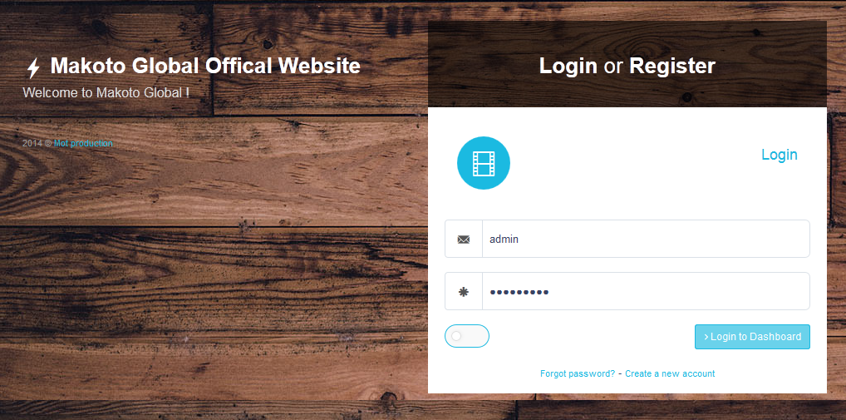
Step1. Using an administrator account login.

Slide 3
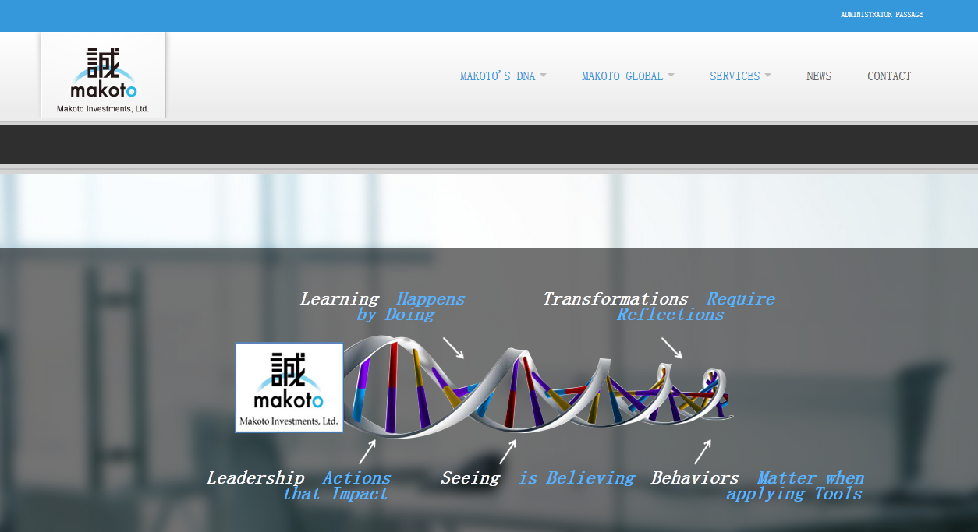
Step2. Click the “ADMINSITRATOR PASSAGE” .

Slide 4
Edit website content
Makoto web system

Slide 5
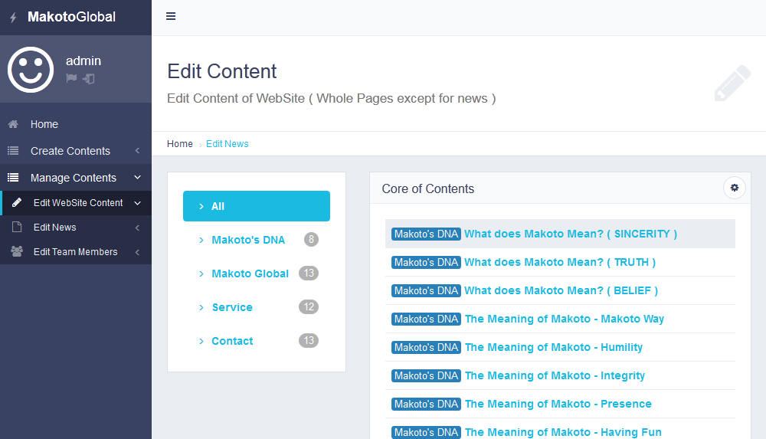
Step1. Click the " Manage Content " and enter " Edit Website Content ".

Slide 6
① This is a edit of the information on this " Makoto`s DNA " page.
② This is a edit of the information on this " Makoto Global " page.
③ This is a edit of the information on this " Service " page.
④ This is a edit of the information on this " Contact " page.
①
②
③
④

Slide 7
Step2. Click into " What does Makoto Mean?(SINCERITY) ".

Slide 8
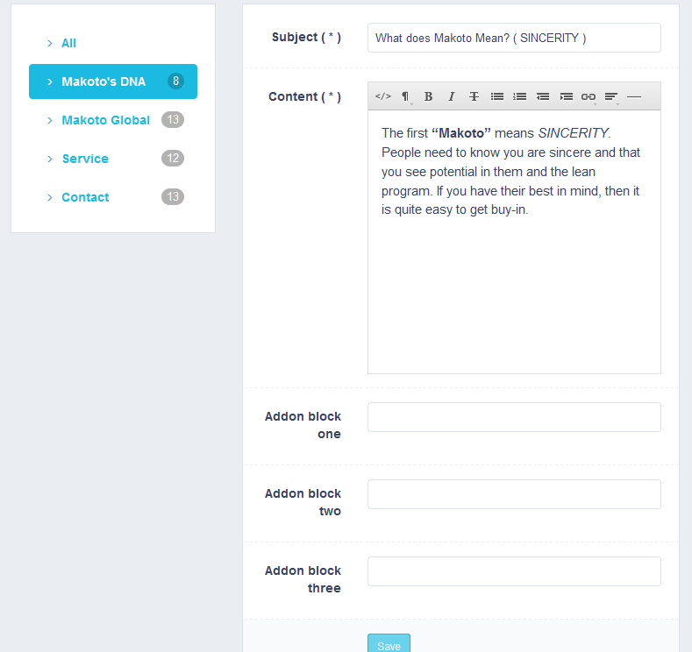
Step3. Fill " * ", and then click the " Save ".

Slide 9
Write a news
Makoto web system

Slide 10
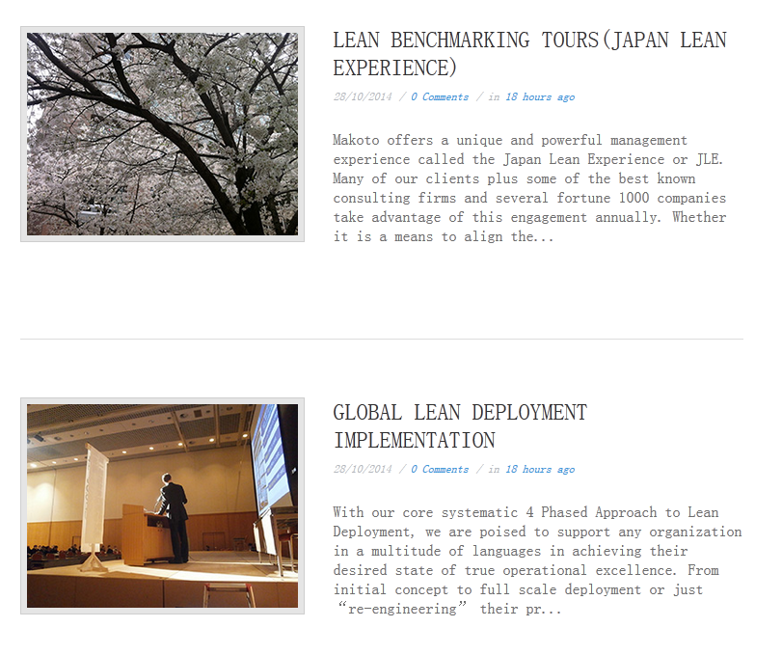
This is examples of news list. Well located on the site " news " page.

Slide 11
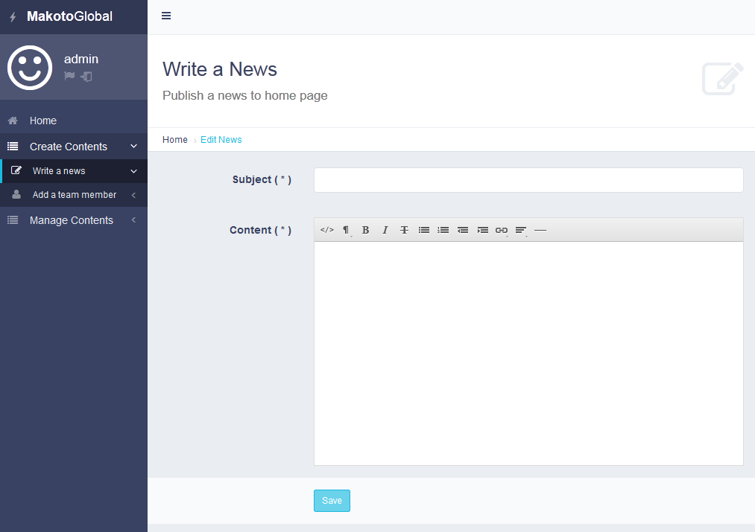
Step1. Click to " Create Contents " and enter " Write a news ".

Slide 12
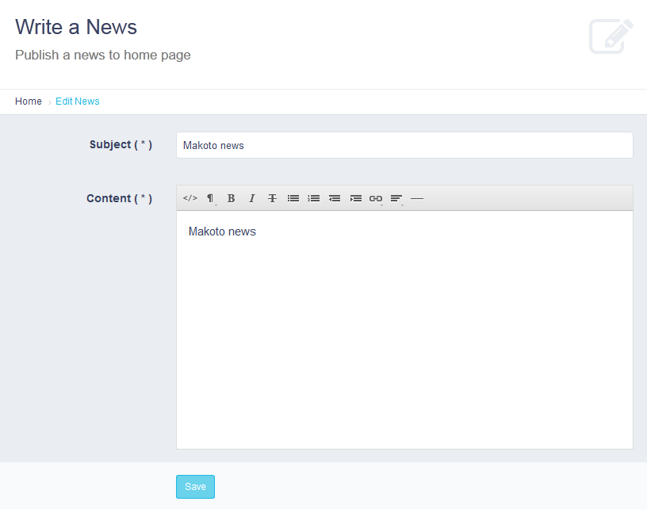
Step2. Fill " * ", and then click " Save ".

Slide 13
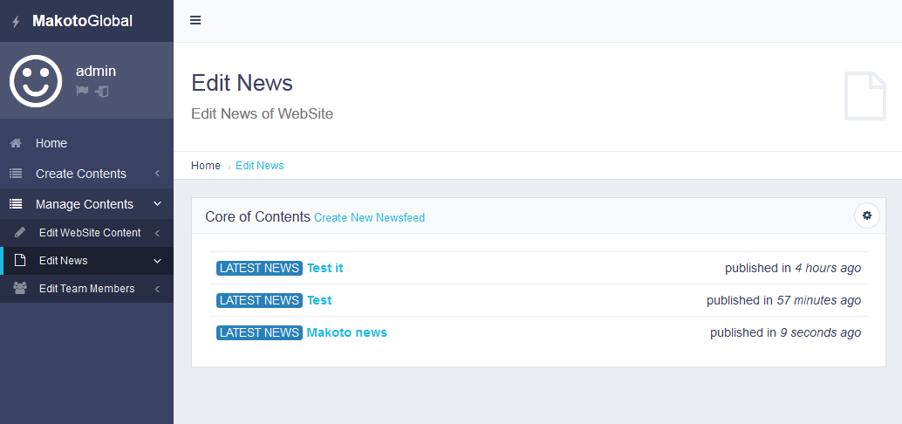
Step3. Click to " Edit WebSite Content " and enter " Edit News ". Here is the news
list .

Slide 14
Step4. Click into " Makoto news ".

Slide 15
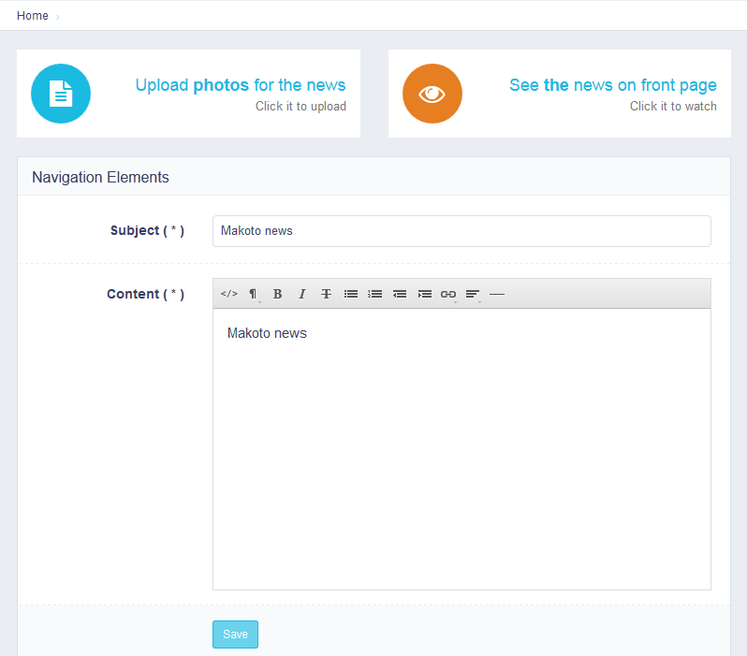
Step5. You can editor the news. Click on the '' Upload photos for the news '',
Upload News with pictures.

Slide 16
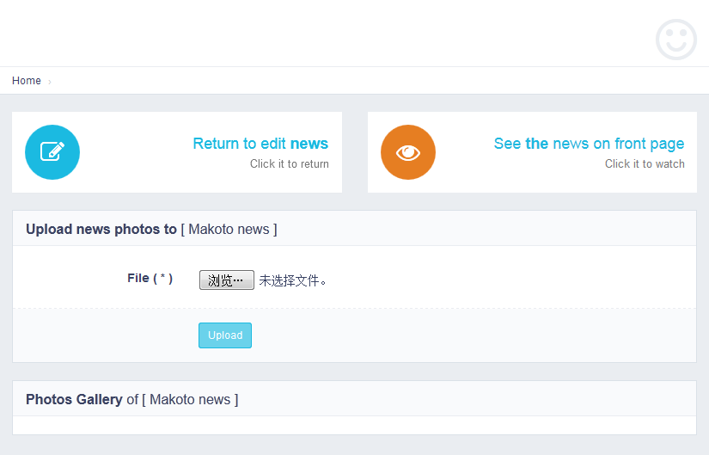
Step6. Click the button to select the picture.

Slide 17
Step7. Click the " Upload ".

Slide 18
Step8. Click the " Return to edit news " .

Slide 19
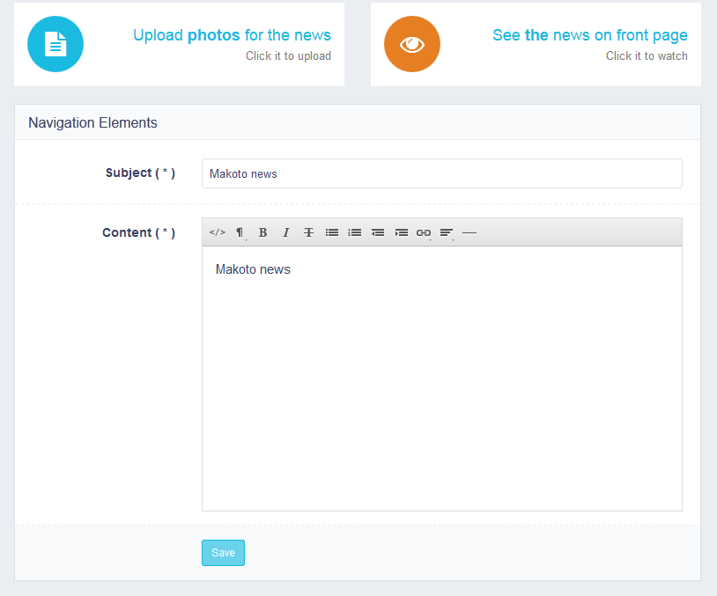
Step9. Click the " Save " .

Slide 20
Add a team member
Makoto web system

Slide 21
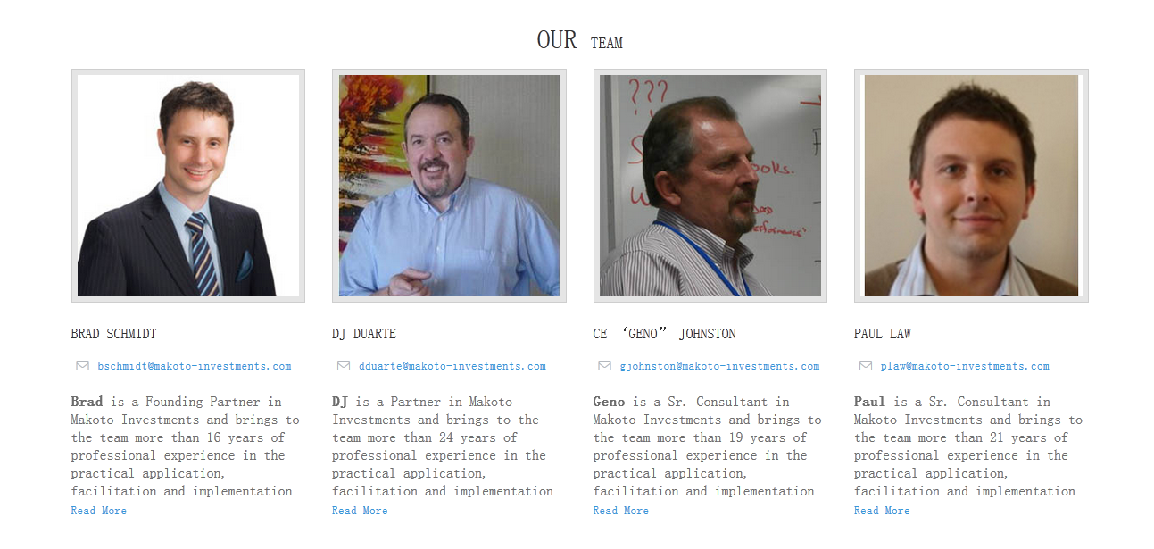
These are examples of member information. Well located on the site " Contact " page.

Slide 22
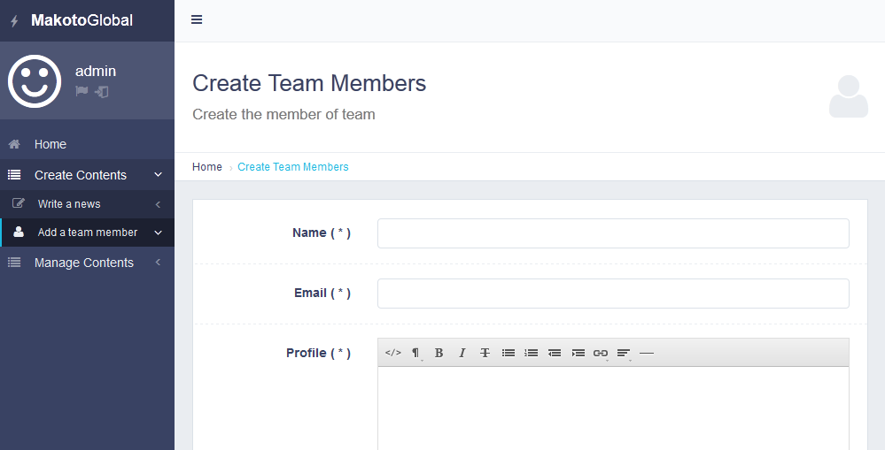
Step1. Click to " Create Contents " and enter " Add a team member ".

Slide 23
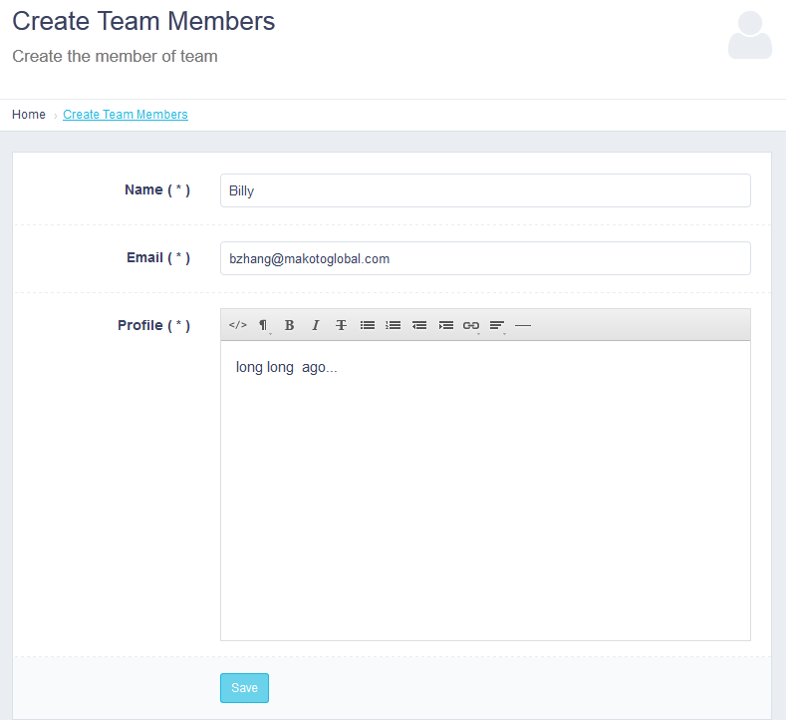
Step2. Fill " * ", and then click the " Save ".

Slide 24
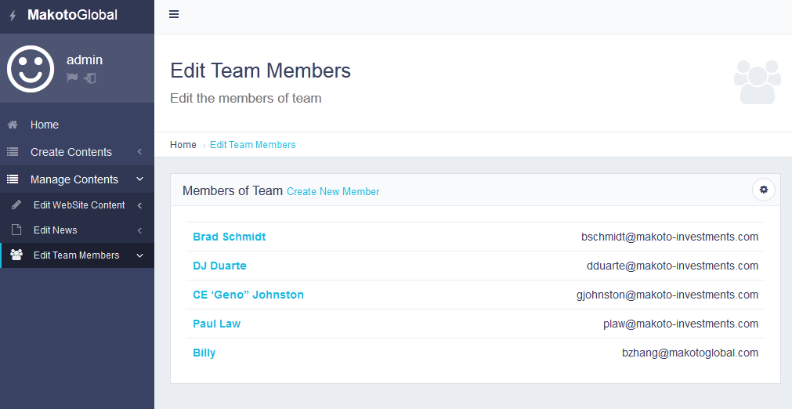
Step3. Click to " Edit WebSite Content " and enter " Edit Team Members ". Here
is the team list .

Slide 25
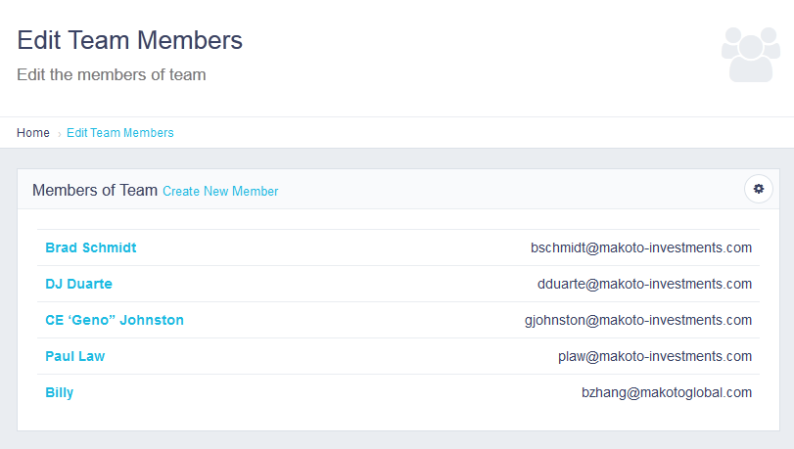
Step4. Click into " Billy ".

Slide 26
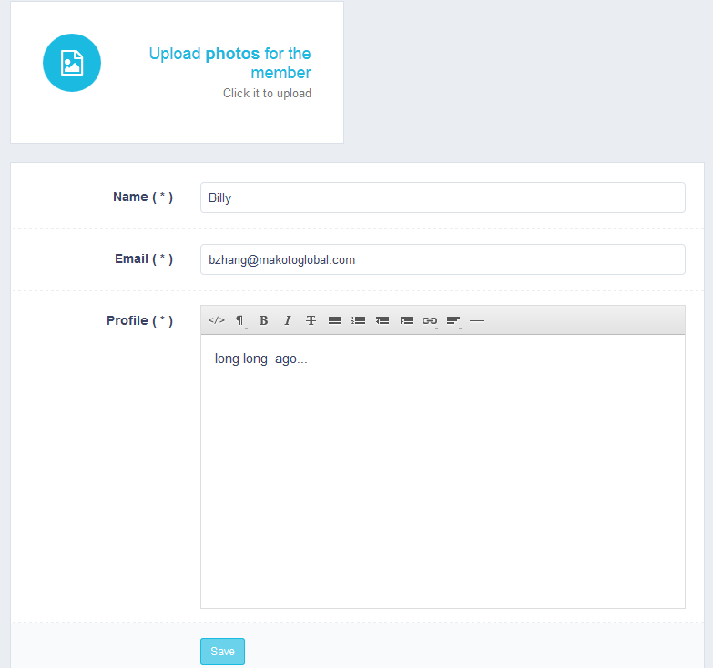
Step5. You can modify the member information. Click on the '' Upload photos for
the member'', Upload member information with pictures.

Slide 27
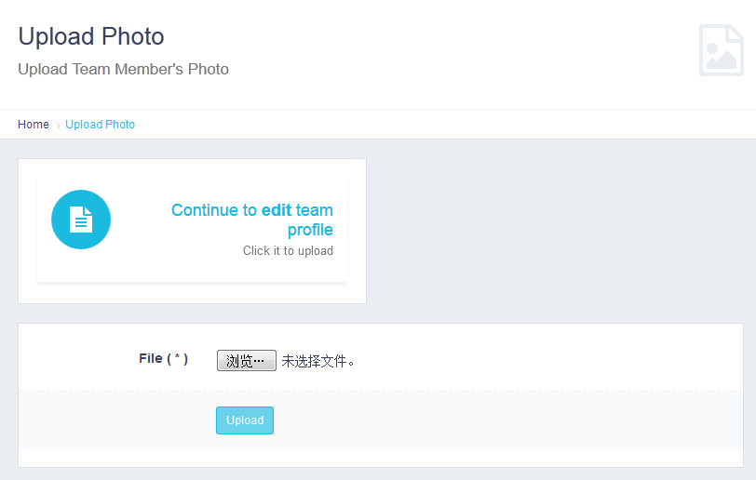
Step6. Click the button to select the picture.

Slide 28
Step7. Click the " Upload ".

Slide 29
Step8. Click the " Return to edit team profile " .

Slide 30
Step9. Click the " Save " .

